Slide 1


Unit 2: Lesson 8
Tell me a story
U ovoj ćete lekciji:
ponoviti past simple (niječni i upitni oblik)
saznati kako se pišu naslovi knjiga
čitati priču o kralju Arturu
izražavati svoje mišljenje o knjigama
pisati scenarij i odglumiti jednu scenu

Slide 2
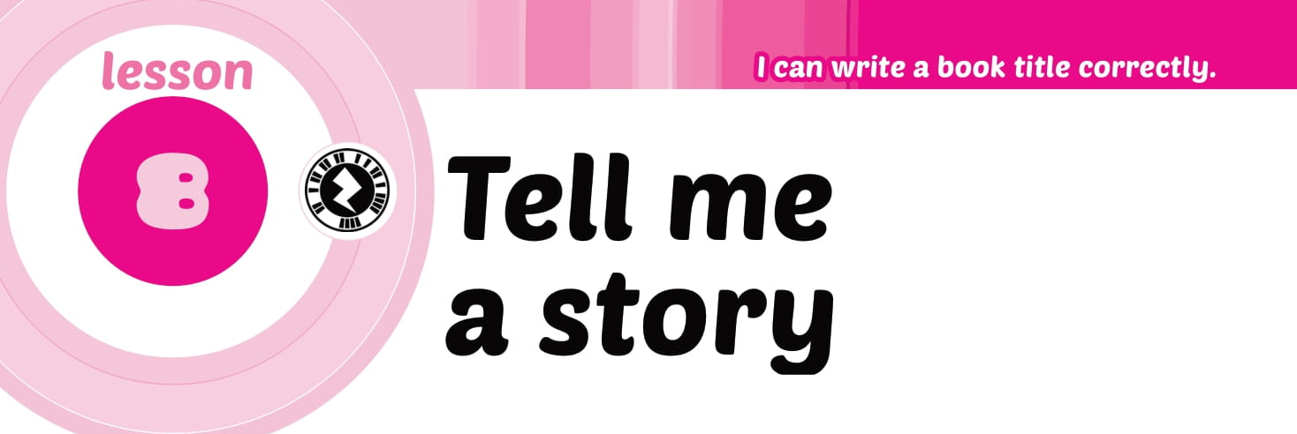
Open your book on page 46.

Slide 3
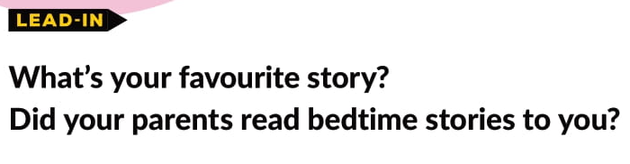
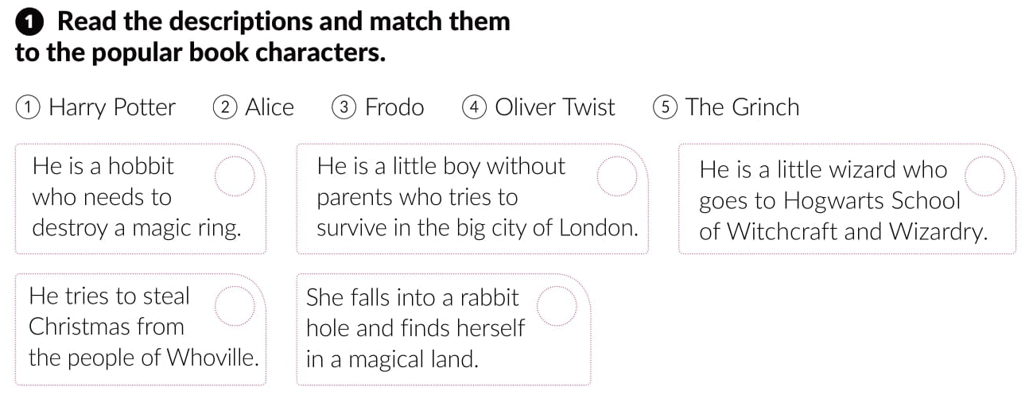
3
4
1
5
2

Slide 4
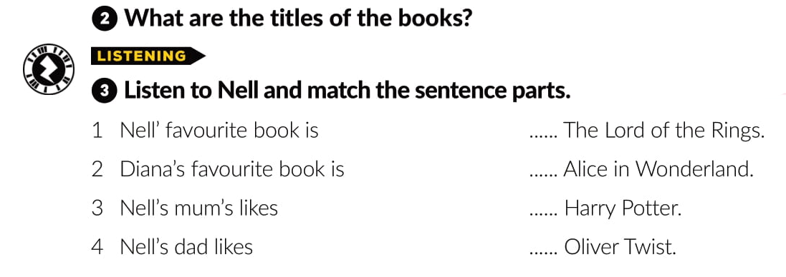
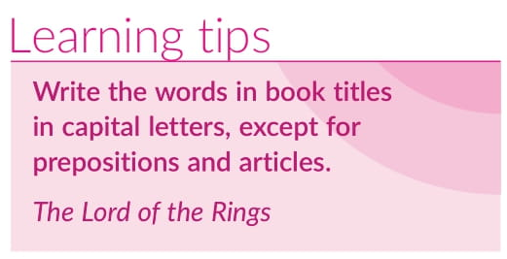
4
2
3
1

Slide 5

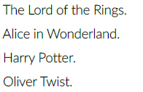
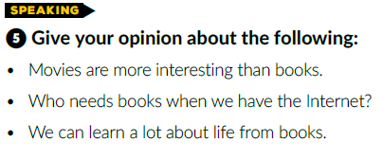

Slide 6
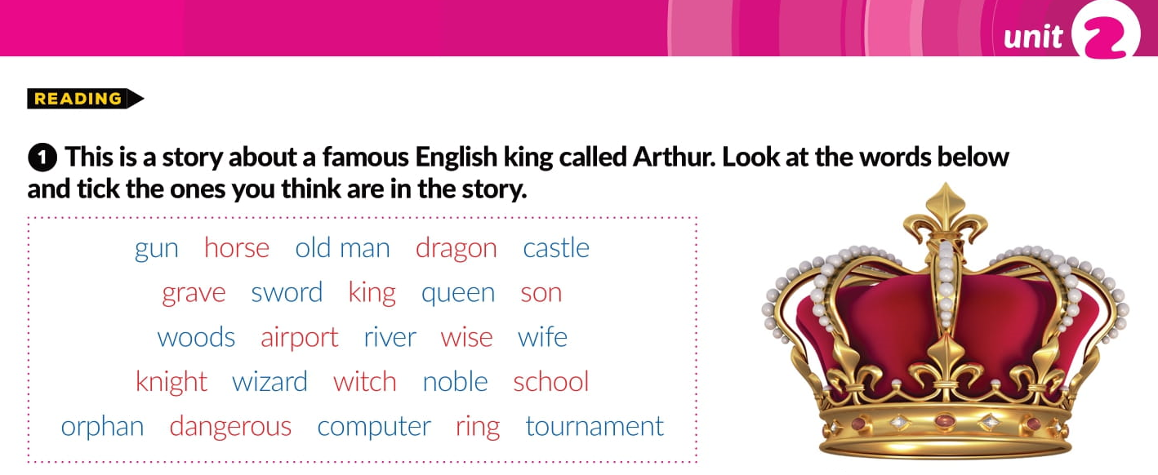


Slide 7
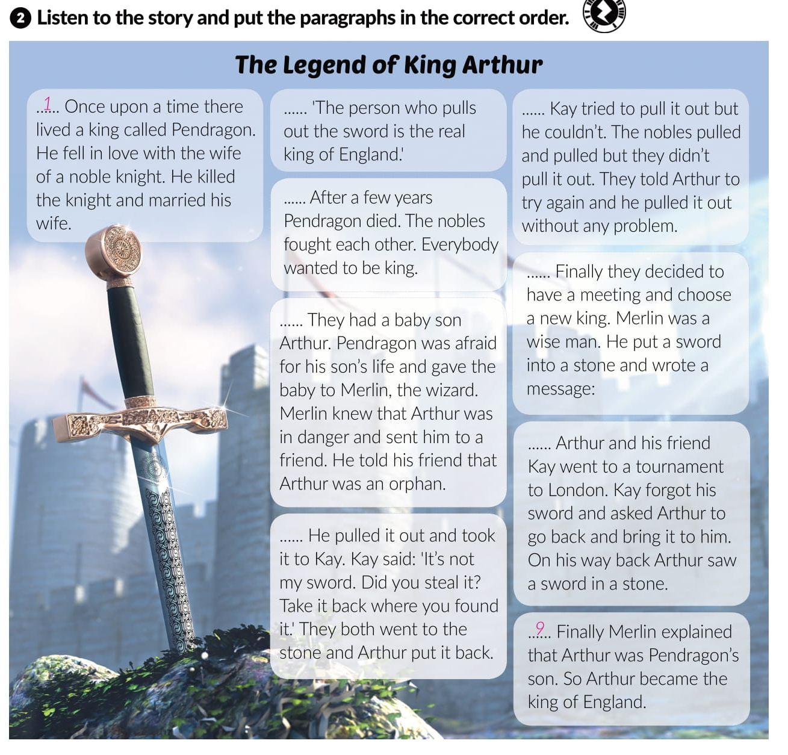
5
8
3
4
2
6
7

Slide 8
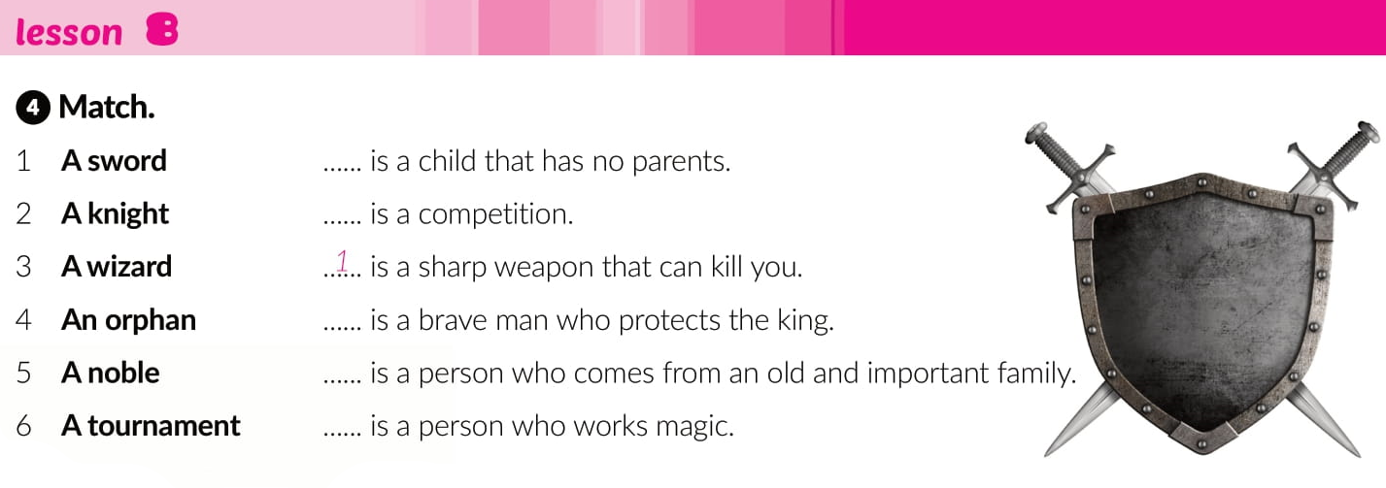
4
6
2
5
3

Slide 9
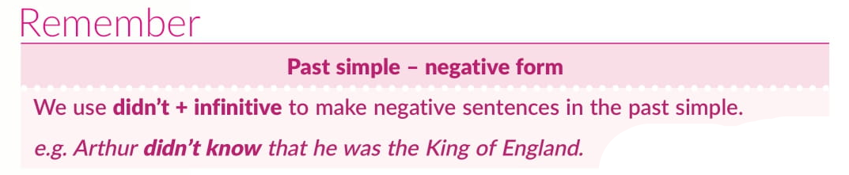
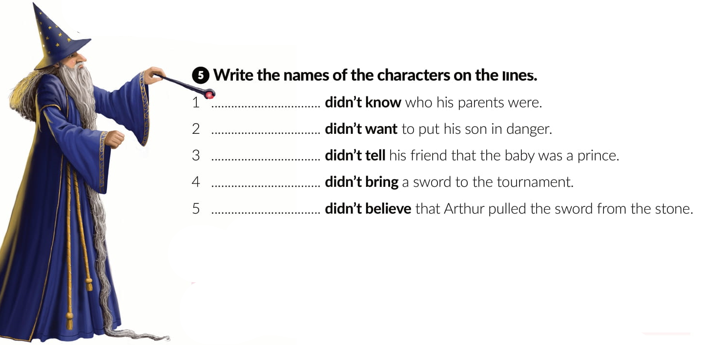
Arthur
Pendragon
Merlin
Kaye
The nobles

Slide 10
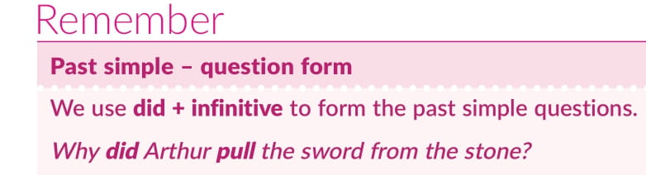
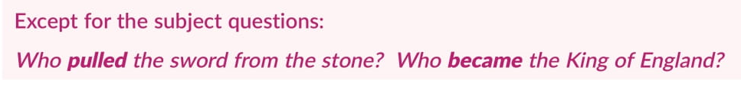
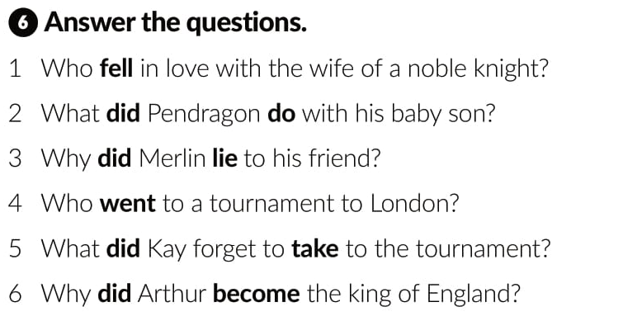
Pendragon fell in love with the wife of a noble kinght.
Pendragon gave his baby son to Merlin, the wizard.
Merlin lied to his friend because he knew Arthur was in danger.
Arthur and his friend Kaye went to London.
Kaye forgot to take his sword to the tournament.
Arthur became the king of England because he pulled out the
sword from the stone.

Slide 11

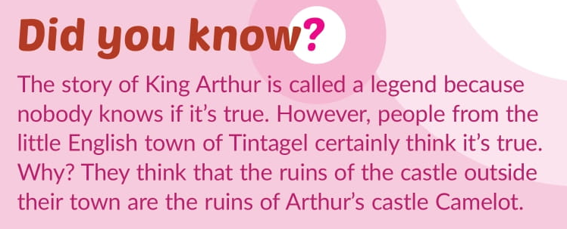
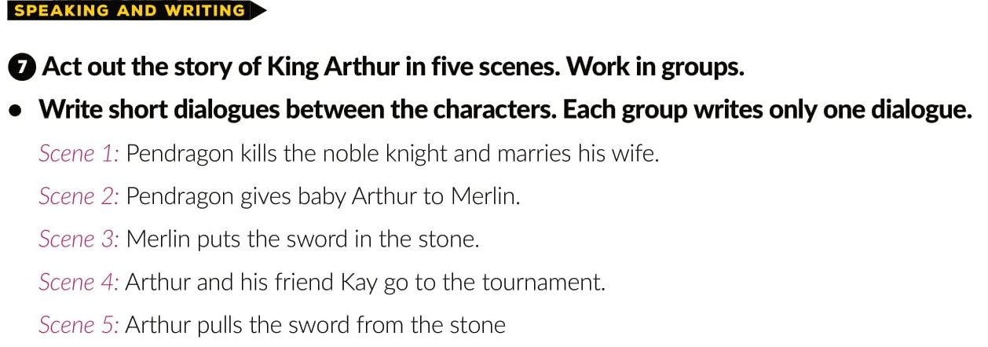

Slide 12
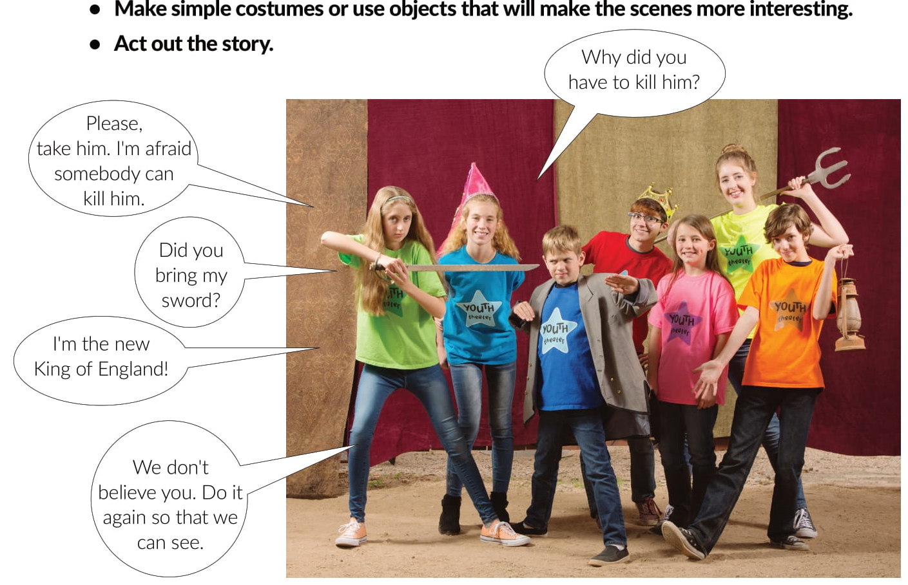

Slide 13
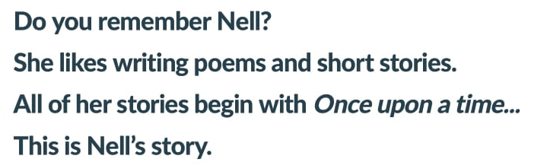

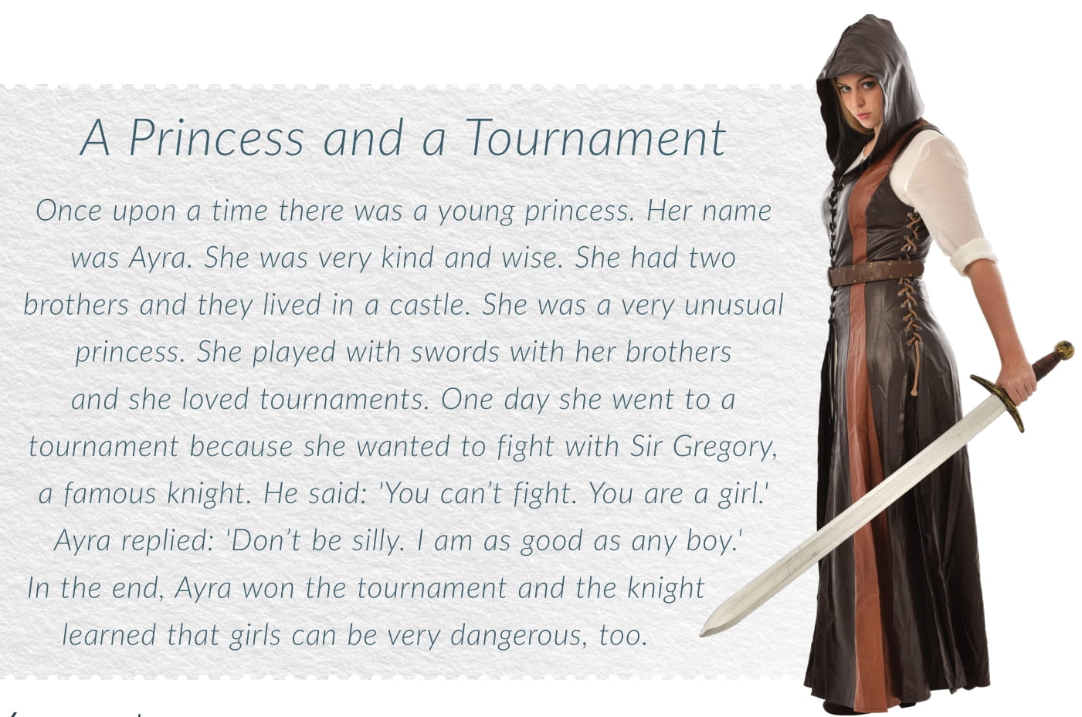

Slide 14
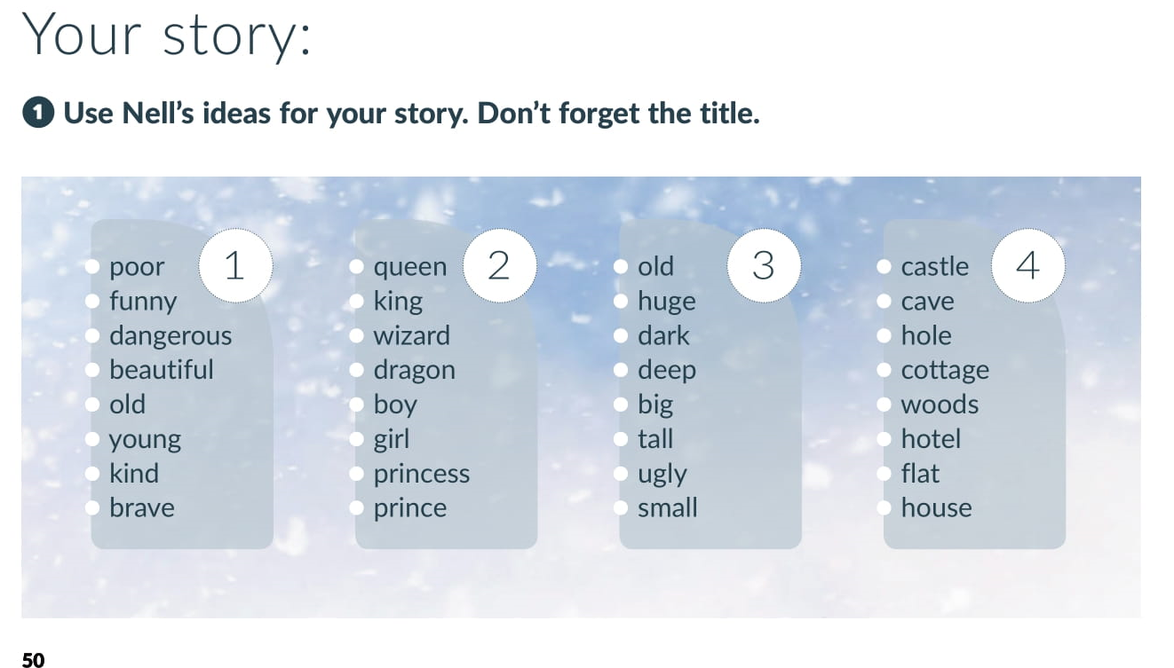

Slide 15
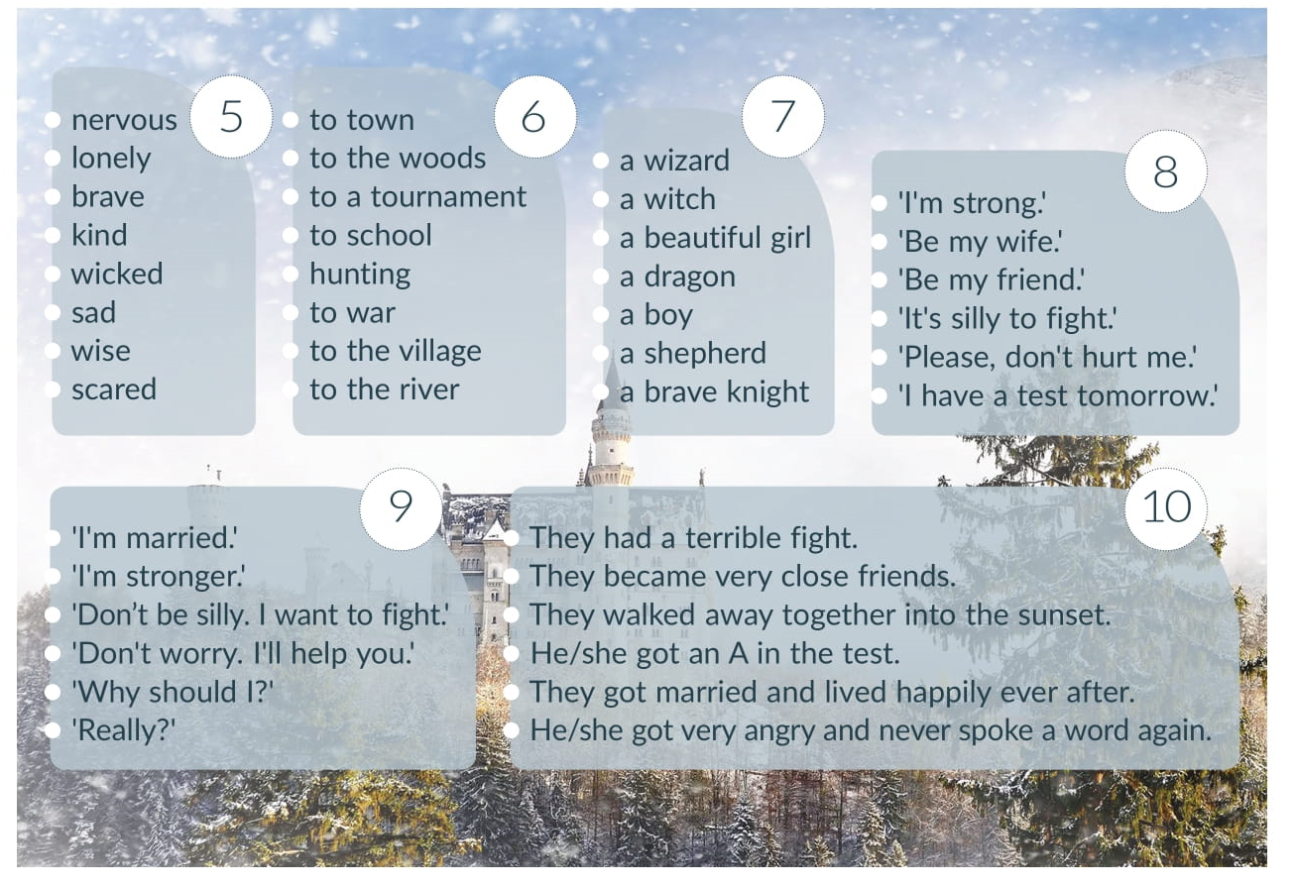

Slide 16
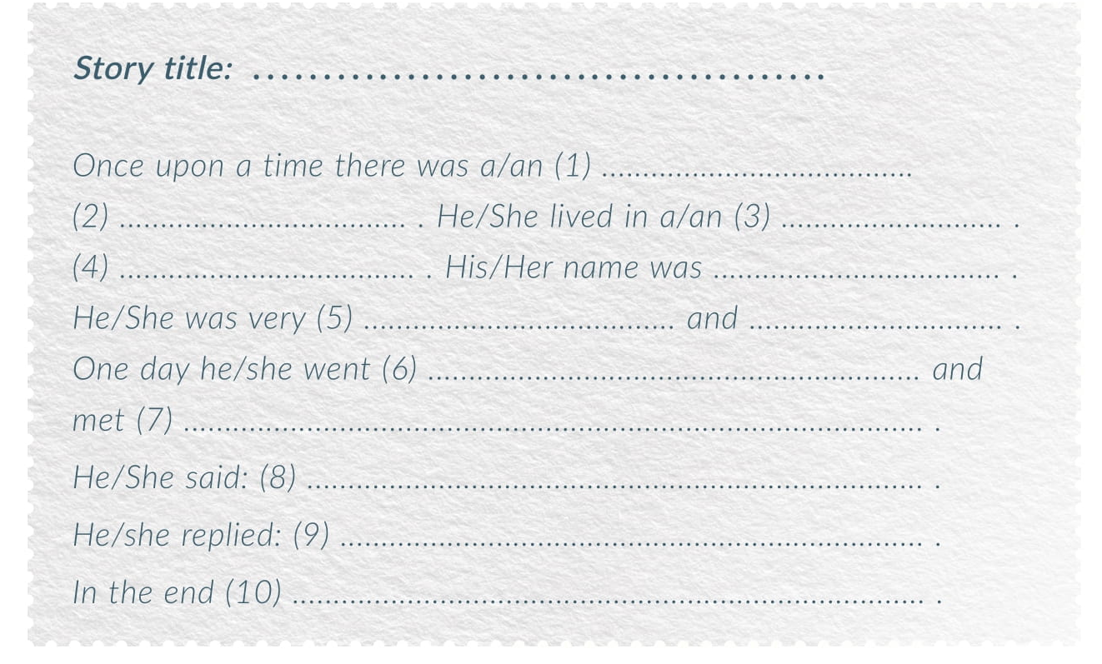


Slide 17
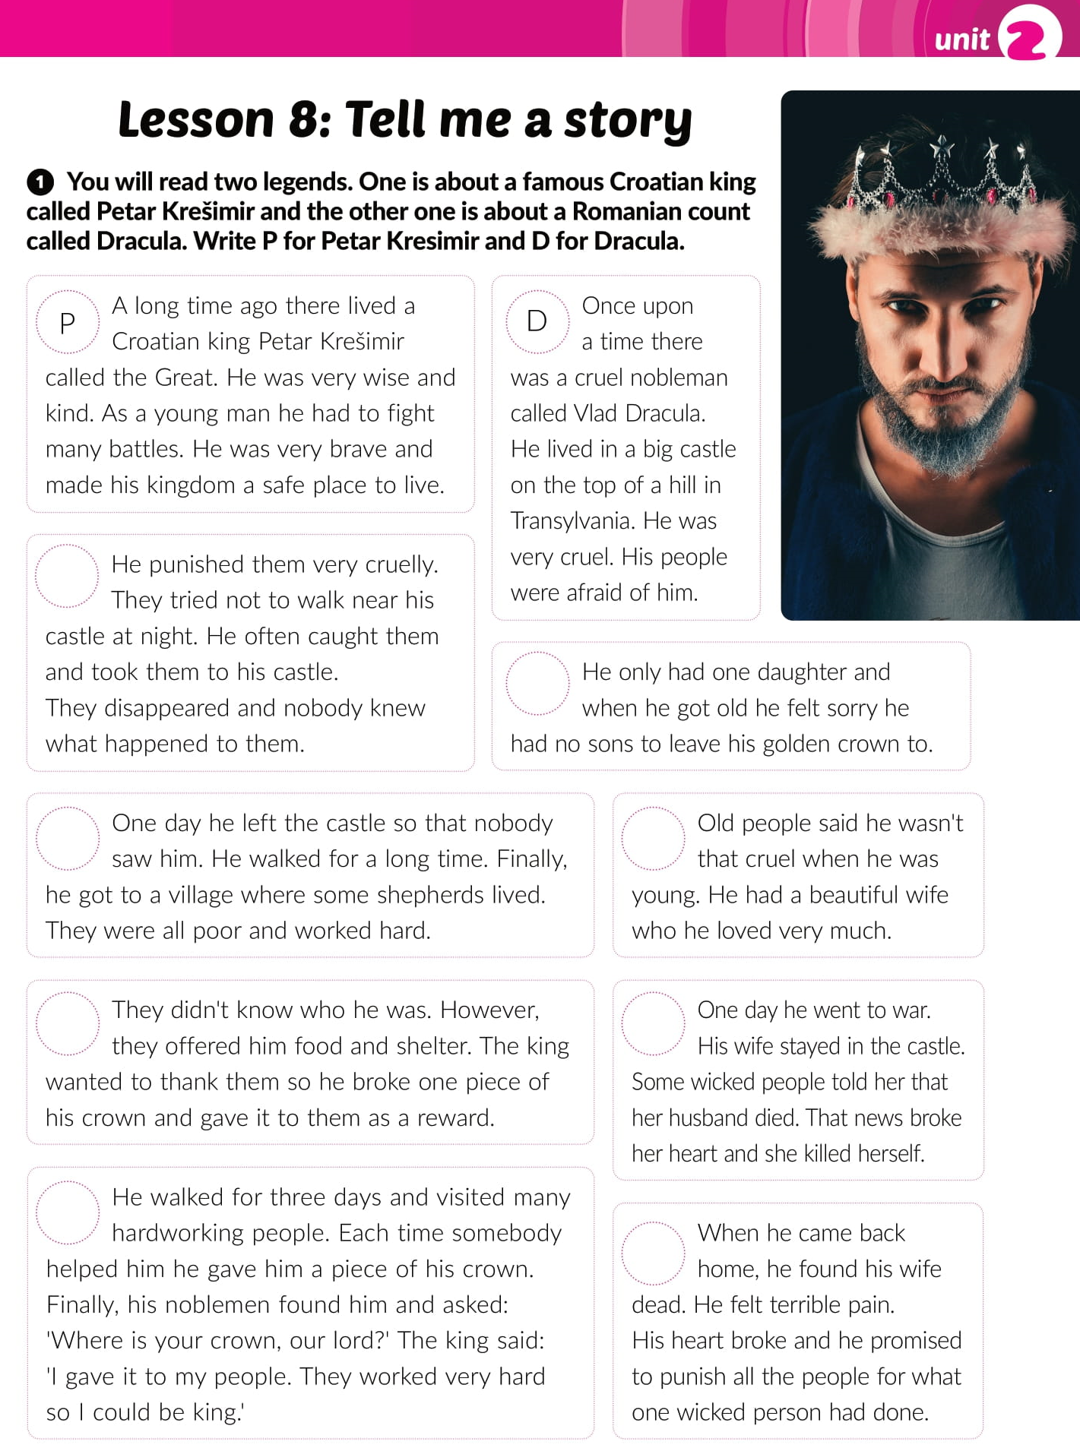
workbook,
page 33.
D
P
P
D
P
D
P
D

Slide 18
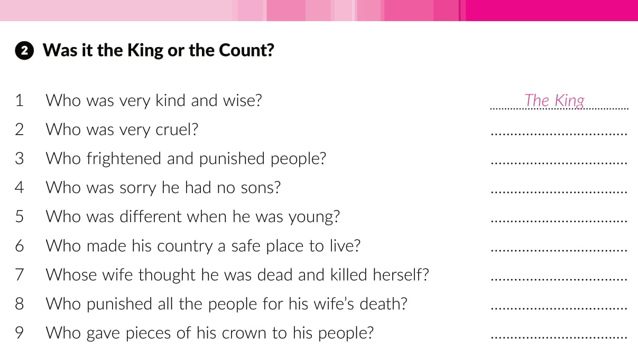
Drakula
Drakula
The King
Drakula
The King
Drakula’s
Drakula
The King

Slide 19
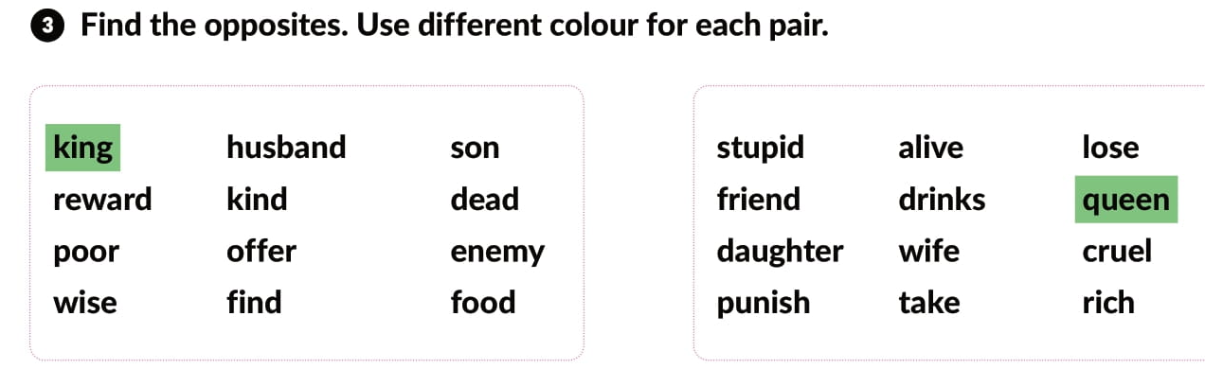

Slide 20
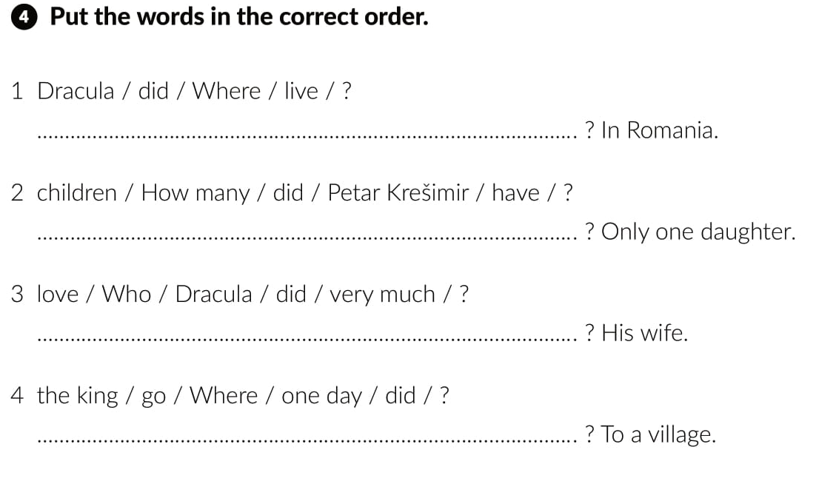
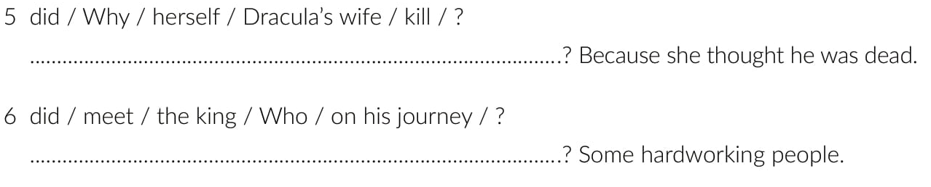
Where did Dracula live
How many children did Petar Krešimir have
Who did Dracula love very much
Where did the king go one day
Why did Dracula’s wife kill herself
Who did the king meet on his journey

Slide 21
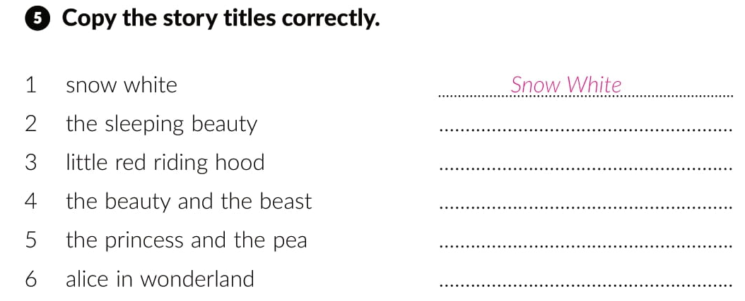
The Sleeping Beauty
Little Red Riding Hood
The Beauty and the Beast
The Princess and the Pea
Alice in Wonderland

Slide 22
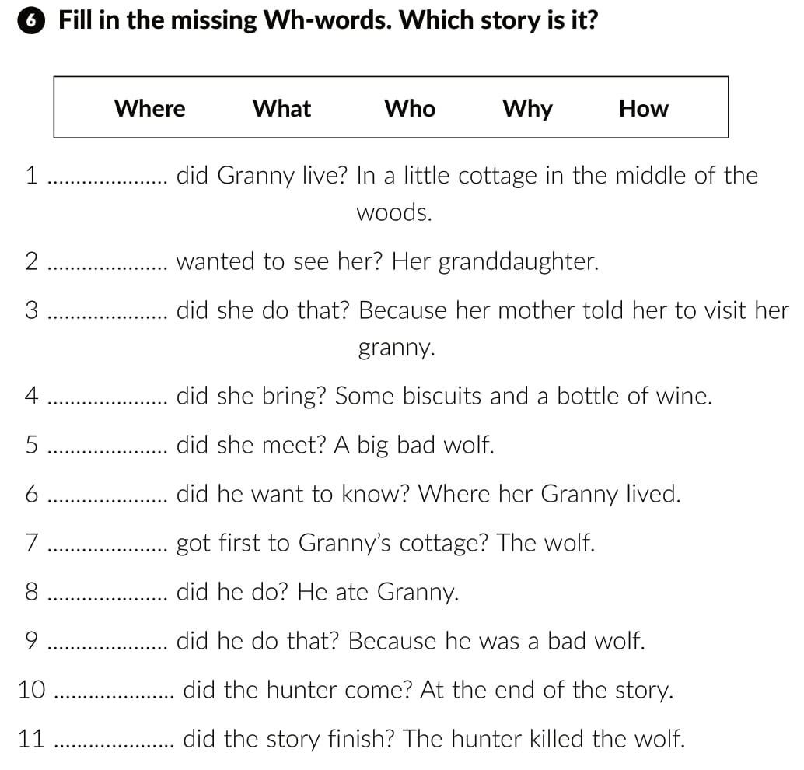
Where
Who
Why
What
Who
What
Who
What
Why
When
How

Slide 23
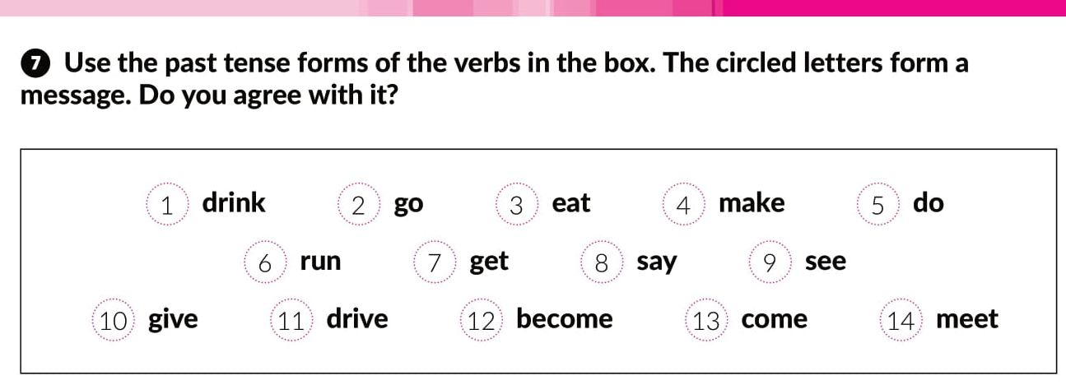
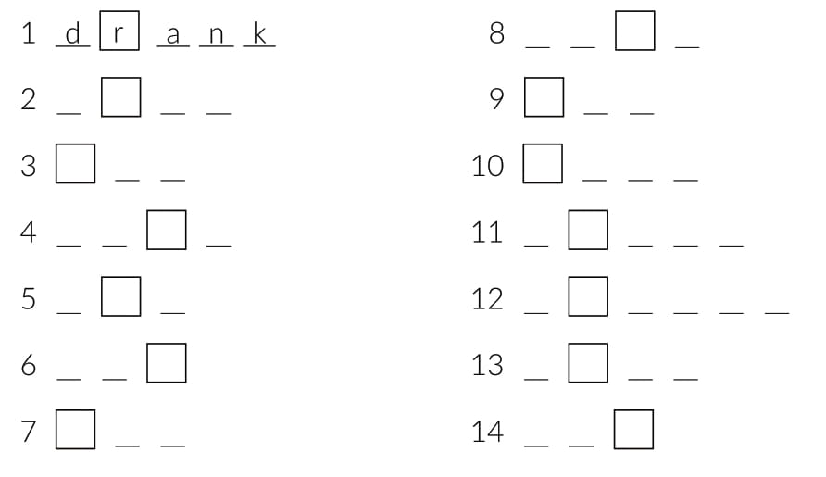

said
went
saw
ate
gave
made
drove
did
became
ran
came
got
met

Slide 24
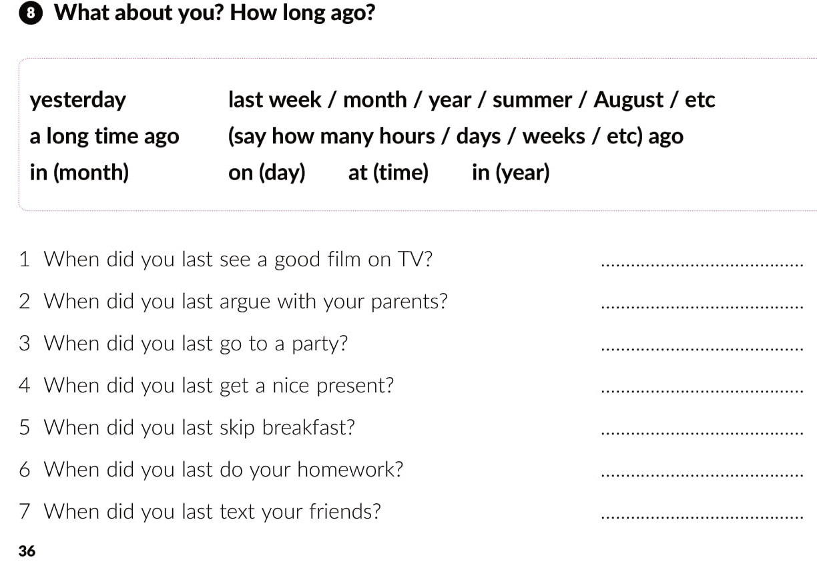

Slide 25
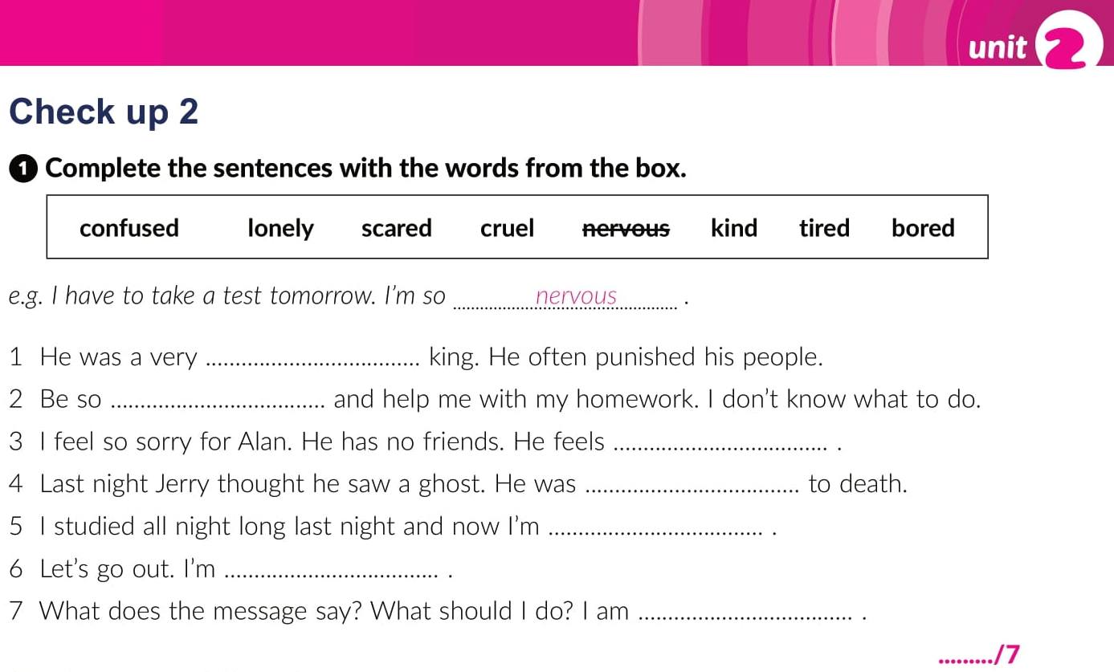
cruel
kind
lonely
scared
tired
bored
confused

Slide 26
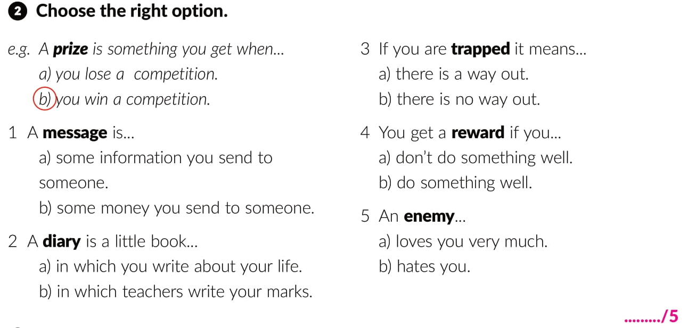

Slide 27
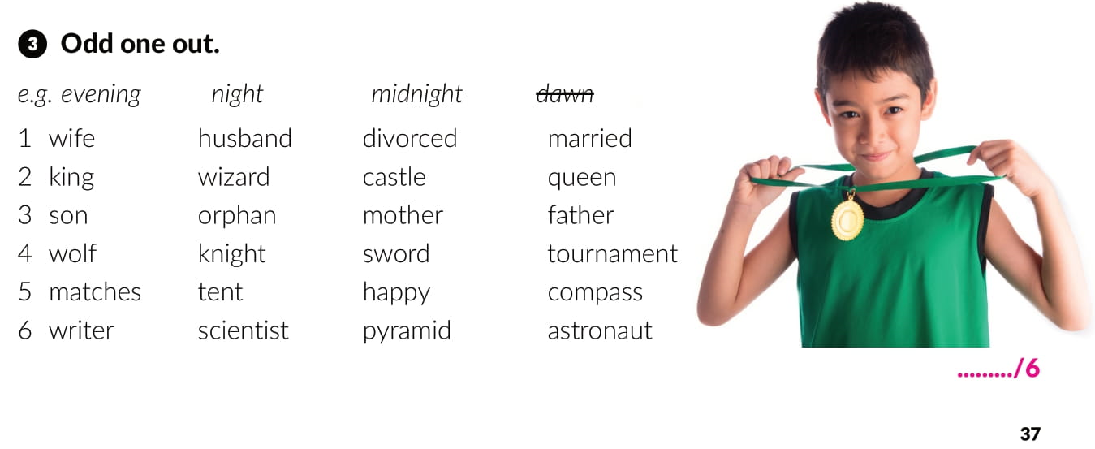

Slide 28
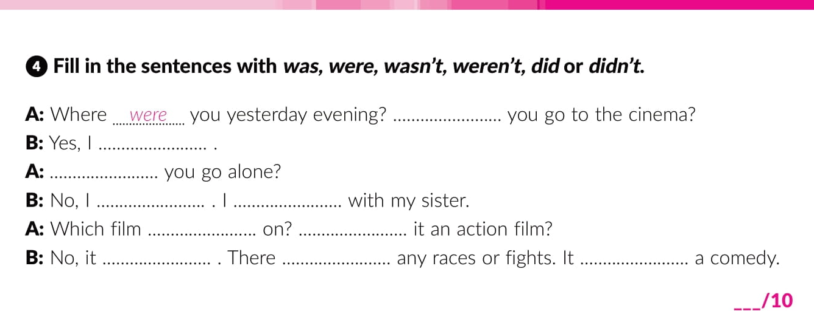
Did
did
Did
didn’t
was
was
Was
wasn’t
weren’t
was

Slide 29
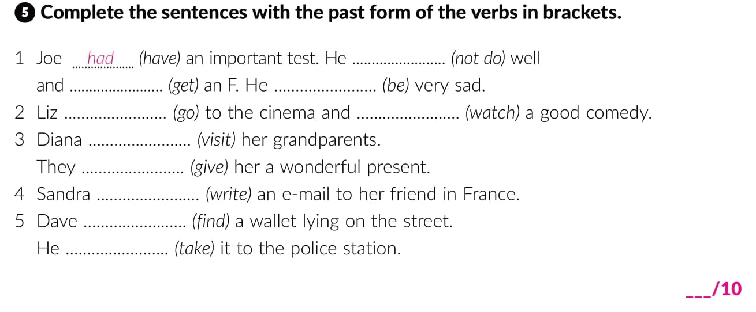
didn’t do
got
was
went
watched
visited
gave
wrote
found
took

Slide 30
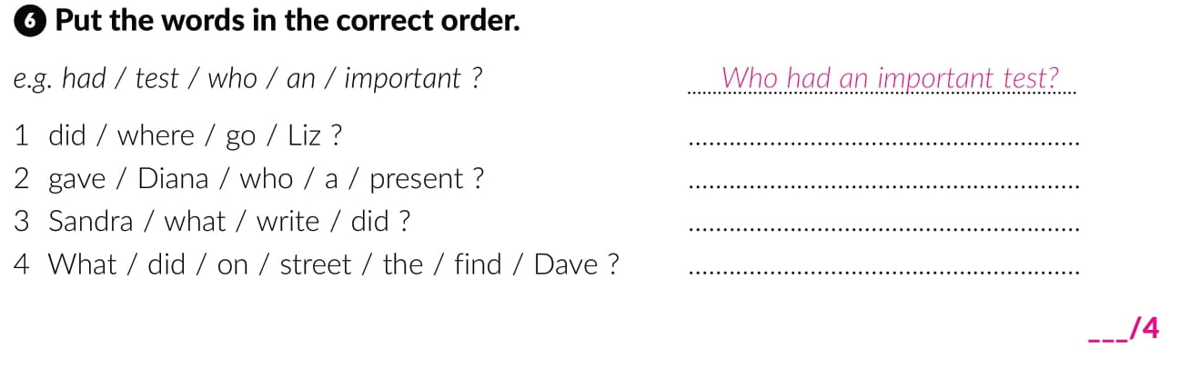
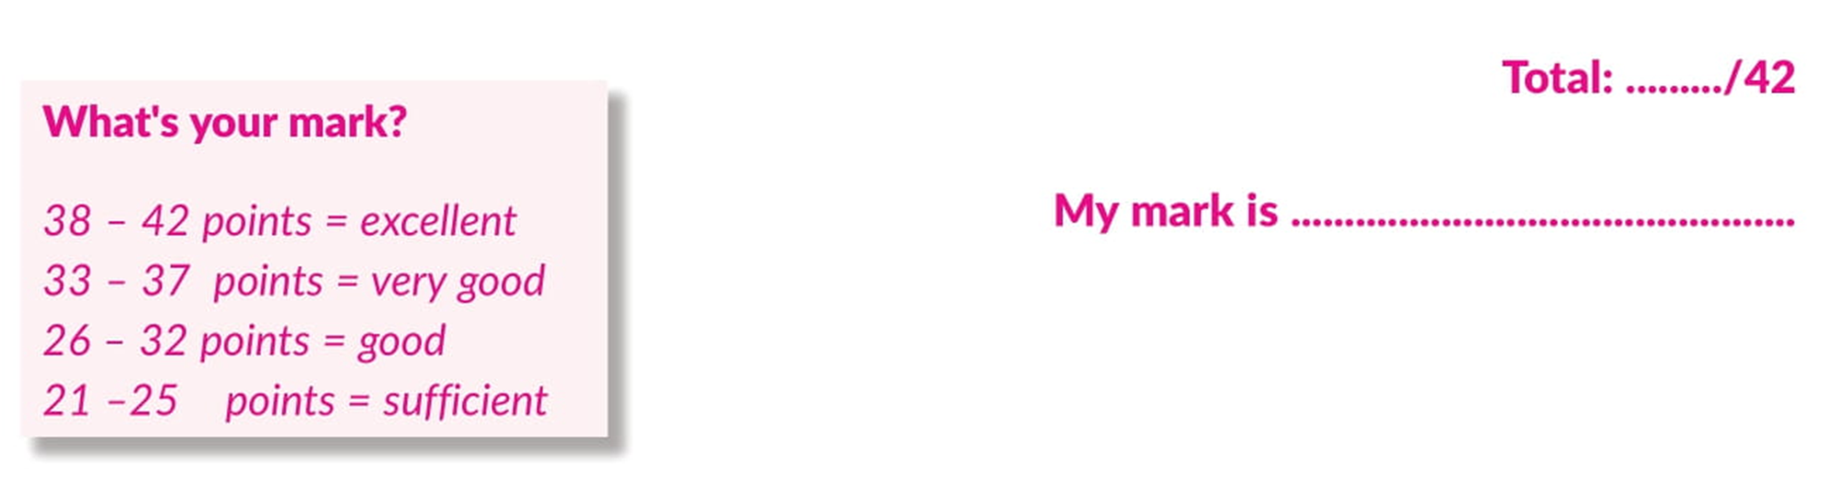
Where did Liz go?
Who gave Diana a present?
What did Sandra get?
What did Dave find on the street?

Slide 31
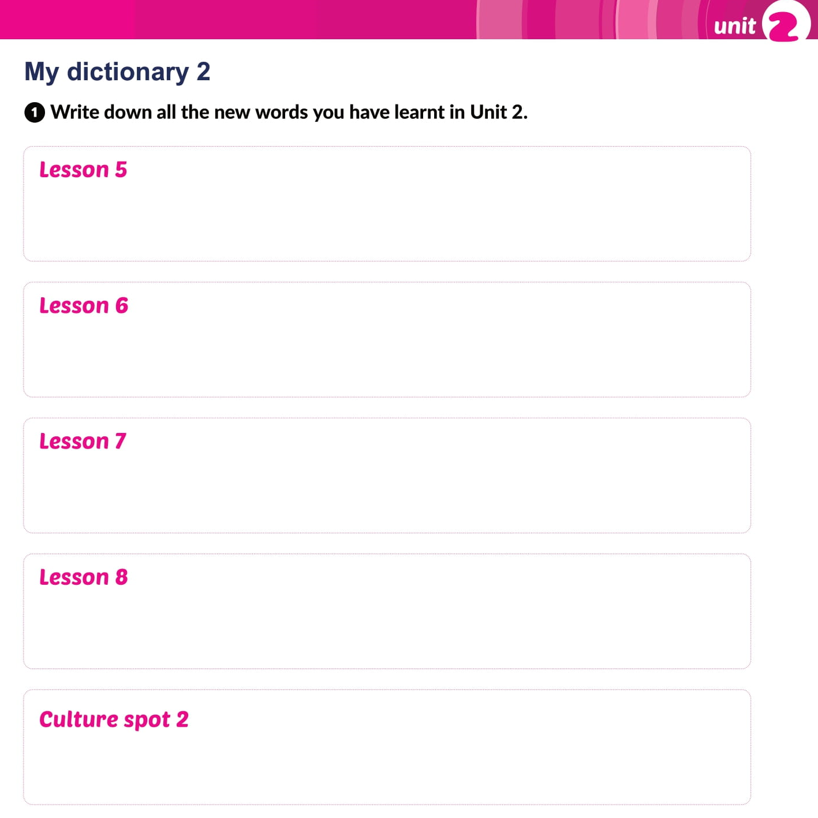
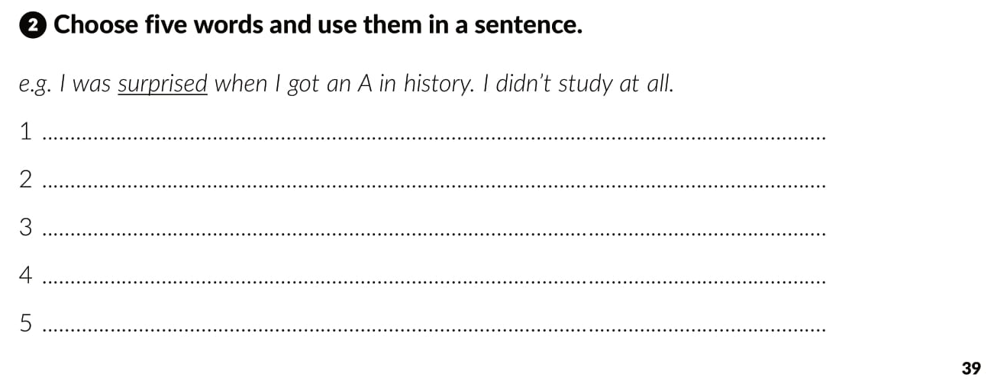

Slide 32

Otvori sljedeću poveznicu i odaberi PLAY AND LEARN!
Lesson 8 Tell me a story | Way to go 3 (e-sfera.hr)

